Slide 1
Testing

Slide 2

Sprint Updates
Client Meetings
How have client meetings gone?
Any requirement changes?
Lab Advisors
Regular Lab advisor meeting?
Sprint Progress
Any blockers?

Slide 3

Why Test
Ensure software works as intended
Ensure all the buttons and functions work
Keep software from crashing
Find unintended bugs when newley developed code is added to the system
Protect against hackers
Secure coding, test against injects, data leaks
Keep code efficient
Protect against needless debugging
Ensure algorithms are returning results in a timely manor

Slide 4


Why Test
Ariane 501 failure 1996
An exception was triggered 30 seconds into liftoff by the guidance system
A 64 bit floating point was converted to a 16 bit signed int causing truncation
The rocket self destructed to avoid continuing further on the undesired flight path
Cost of the rocket and cargo was 500 million

Slide 5

Types of Testing
Unit
Smallest test
Testing a function, algorithm or subroutine
End of development
Integration
Testing how well newly developed code works with the system
End of sprint tests
Functional
User experience
Does the UI work as intended
Does the software function as expected
Acceptance
Does the software meet the customers requirements
Does the software meet the business requirement
Will the customer accept delivery of the product

Slide 6
Unit Testing
Smallest section of code that is testable
Often testing output from functions, subroutines or modules within the code base
Examples:
Testing a hashing function is returning accurate and dependable results
Testing if a total function returns an accurate total for an online order
Unit tests preformed after development
Unit testing is preformed by the developer after development
Unit tests should be done before the code is submitted via git commit
During the code peer review the developer should explain code and any unit tests used to verify the code is working as intended

Slide 7
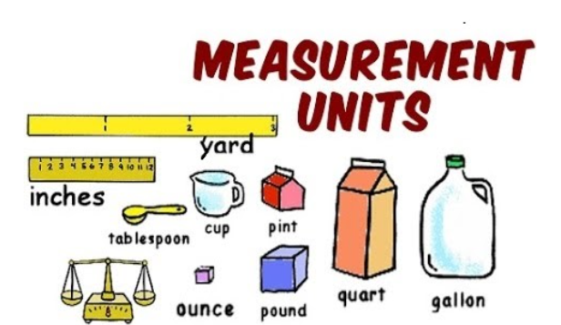
Unit Testing
Start thinking of ways to implement unit testing into your sprint development lifecycle
While developing your sprint task think of how you will unit test the functions you are developing

Slide 8

Integration Tests
During your sprints each developer will submit their developed software, the team should have a designated integrator that pulls all the new code and runs integration testing as well as handles merge conflicts.
Integrator
Handles merge conflicts
Sometimes git commits are in the same module and merge conflicts arise
Runs end of sprint integration tests
Utilizes unit and functional tests as well as test automation to ensure all newly developed code works well together
Most knowledgeable team member
Should be the most experienced team member
Requires a deep understanding of the whole software system
Creates new tests
Sometimes new integration tests are needed to fully test the system

Slide 9

Functional Tests
Functional testing is considered black box testing. The tester does not need to know the inner workings of the software only that the inputs match the output

Slide 10
Functional Tests
Software behaves as expected
Software is not sluggish
Loads quickly
Does not crash
Meets product requirements
All the customer requirements are enabled and working
Site login is seamless
Order information is accurate
Features work
All buttons take you to the correct area of the application
The display outputs accurate information

Slide 11

Acceptance Tests
Acceptance tests are preformed at the end of the software development lifecycle. The acceptance test will ensure all software requirements established by the customer are satisfied

Slide 12
Acceptance Tests
Combination of tests
Already created unit and functional tests will be used to verify requirements are met
New tests may also be created
Acceptance
Each customer software requirement is tested to prove that the requirement has been met
Failed requirements must be accurately recorded
Delivery
A test document will be provided to the customer at the end of development
The customer can accept or reject the software product based off the acceptance testing
Acceptance testing proves you met the software requirements

Slide 13

Sprint Testing
Unit tests
Think of unit tests to add while developing
Unit test your code before the git commit
Integration tests
Pick a integrator for your team
Think of some integration tests
Perform integration testing after git commits and peer reviews

Slide 14
Sprint Cycle
Sprint Planning | Software Development | Unit Testing | Git Commit | Peer code Reviews | Integration testing | Deployment | Sprint Retrospective
Follow the Sprint testing flow
Unit test code if possible before submitting to git for code peer review.
Submitted code to the repository should be as polished as possible

Slide 15

Questions
Next Lecture
Unit Testing
Future Lectures
Test Automation
Test Report
Continuous Integration CI

